Slide 1

CE101 Engineering Drawing Lec7: Section of Solids
Indian Institute of Technology Guwahati
Notes:
Today we will discuss about the Modeling and

Slide 2
FEW TYPICAL EXAMPLES Part II
(QUESTION NOT PROVIDED)

Slide 3
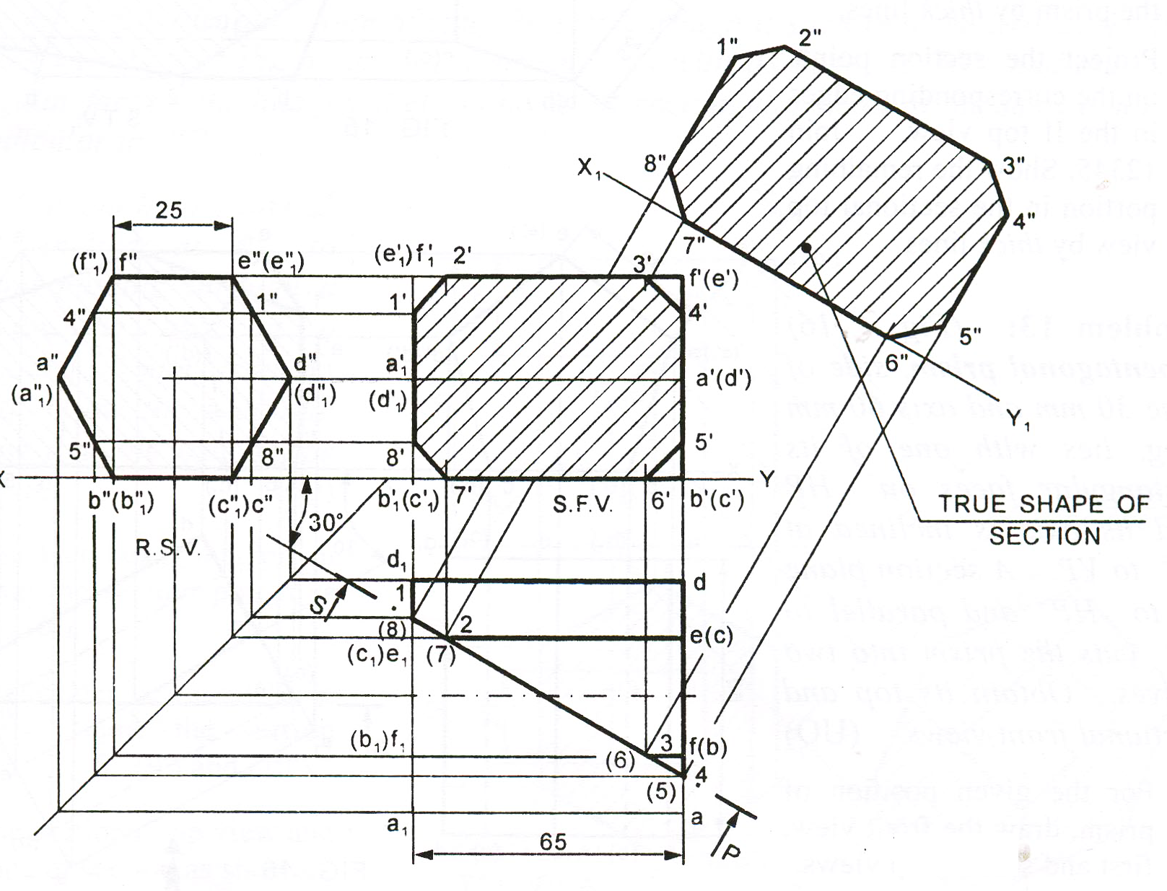

Slide 4
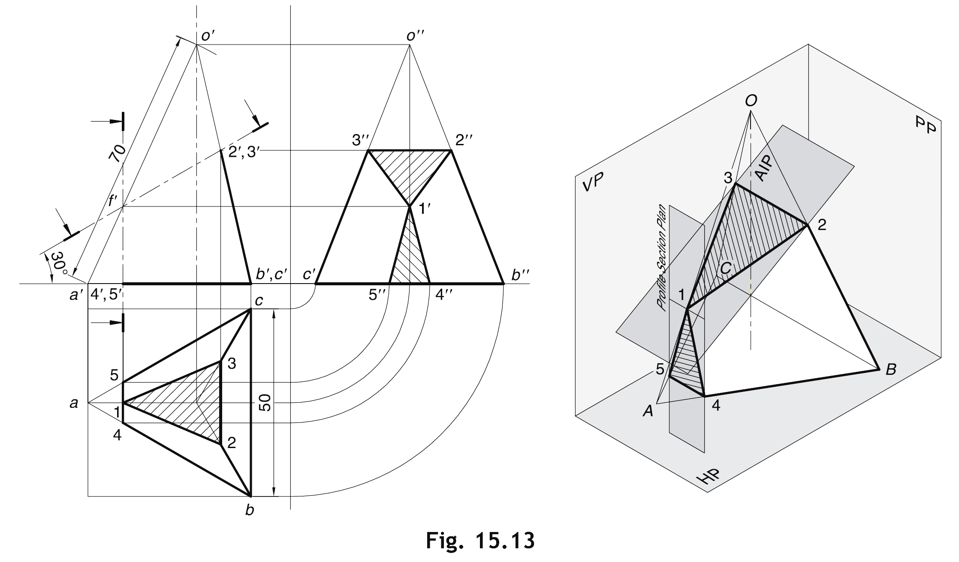
Two section planes acting simultaneously
(AIP and Vertical section plane)

Slide 5
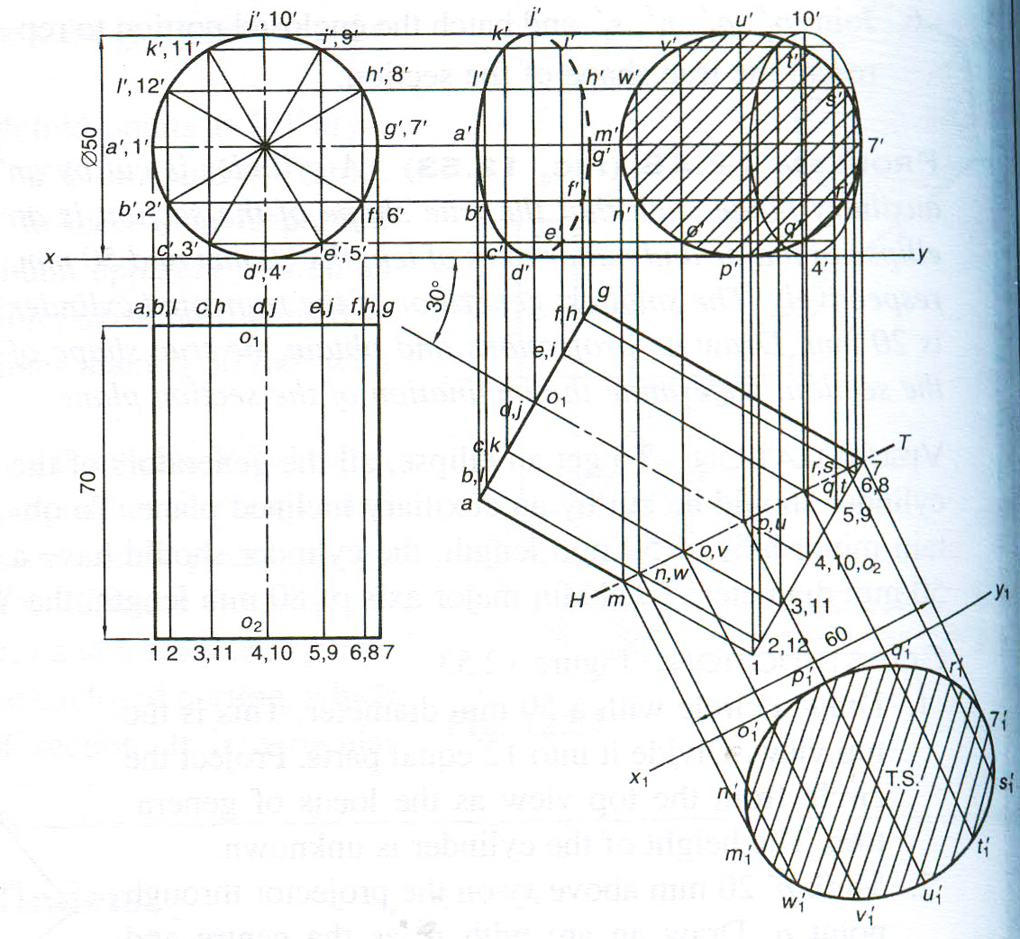

Slide 6
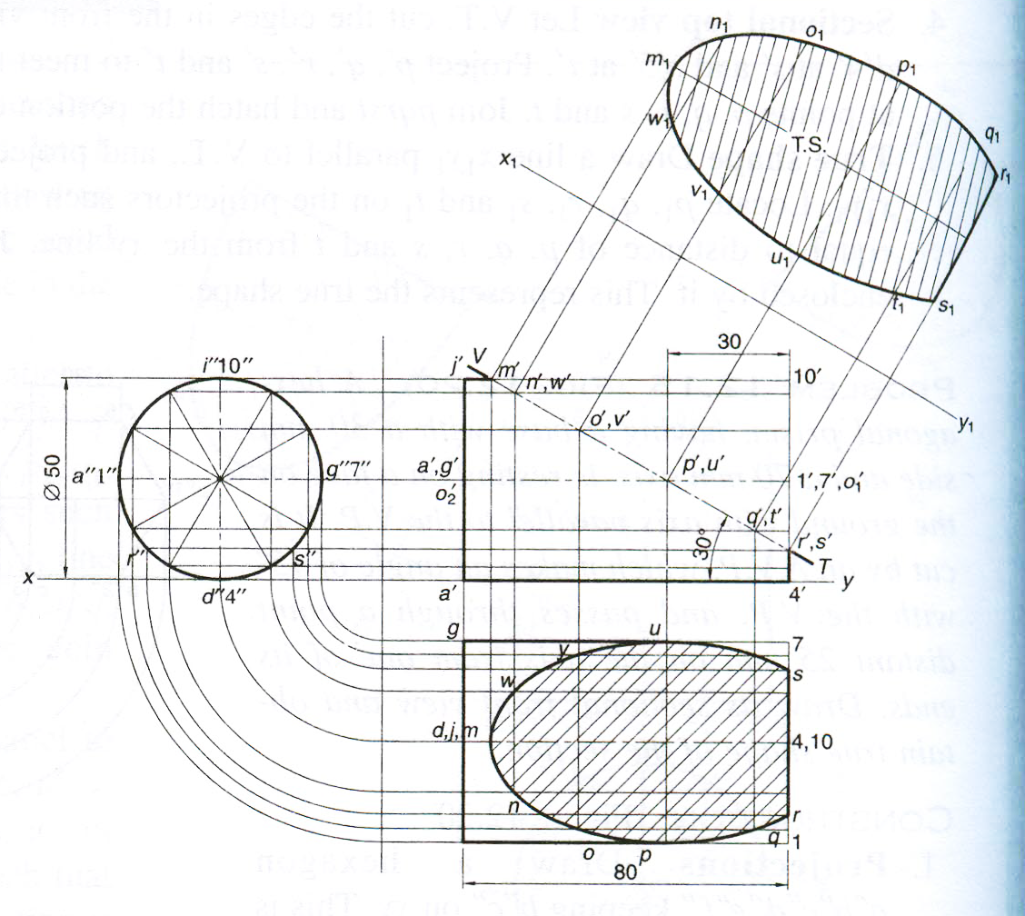

Slide 7
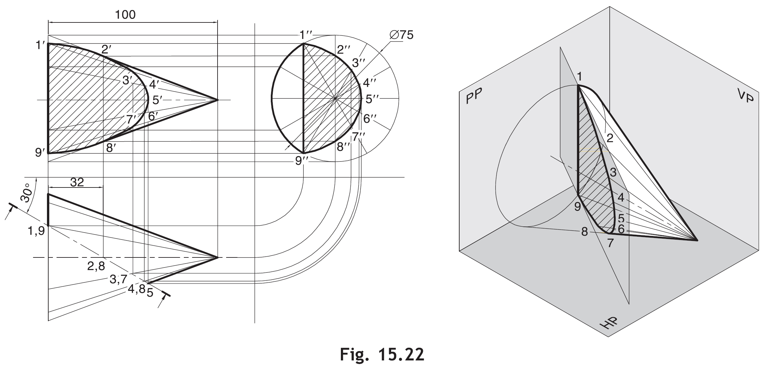

Slide 8
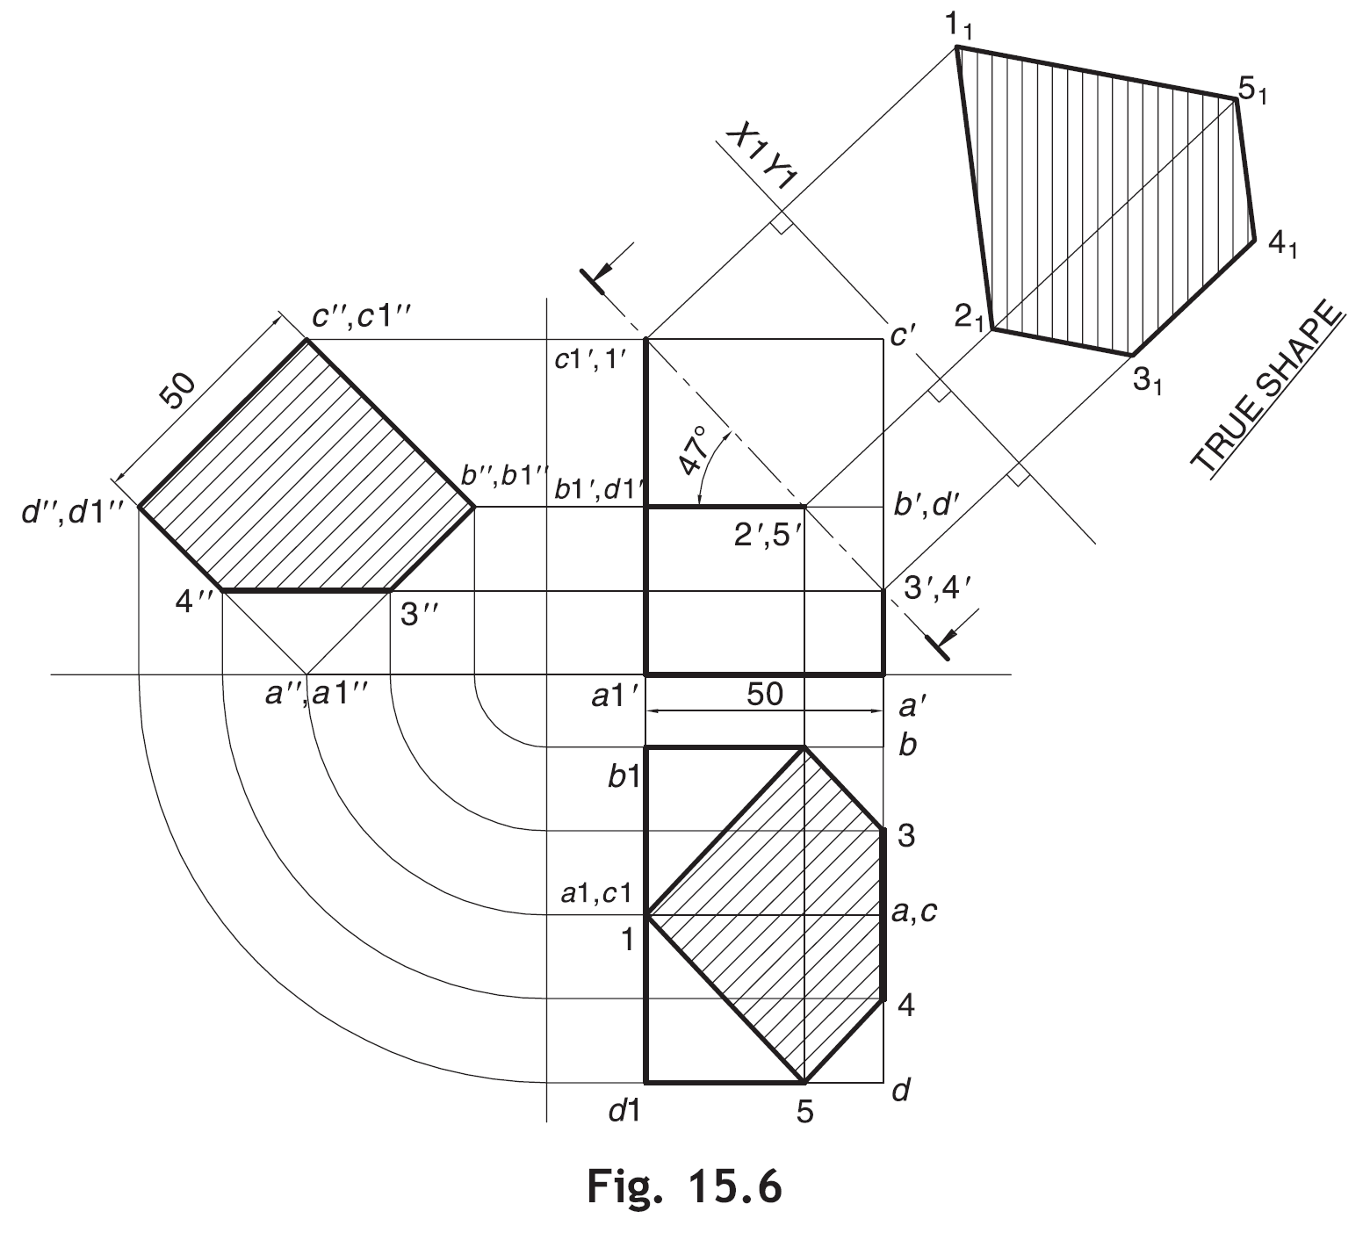

Slide 9
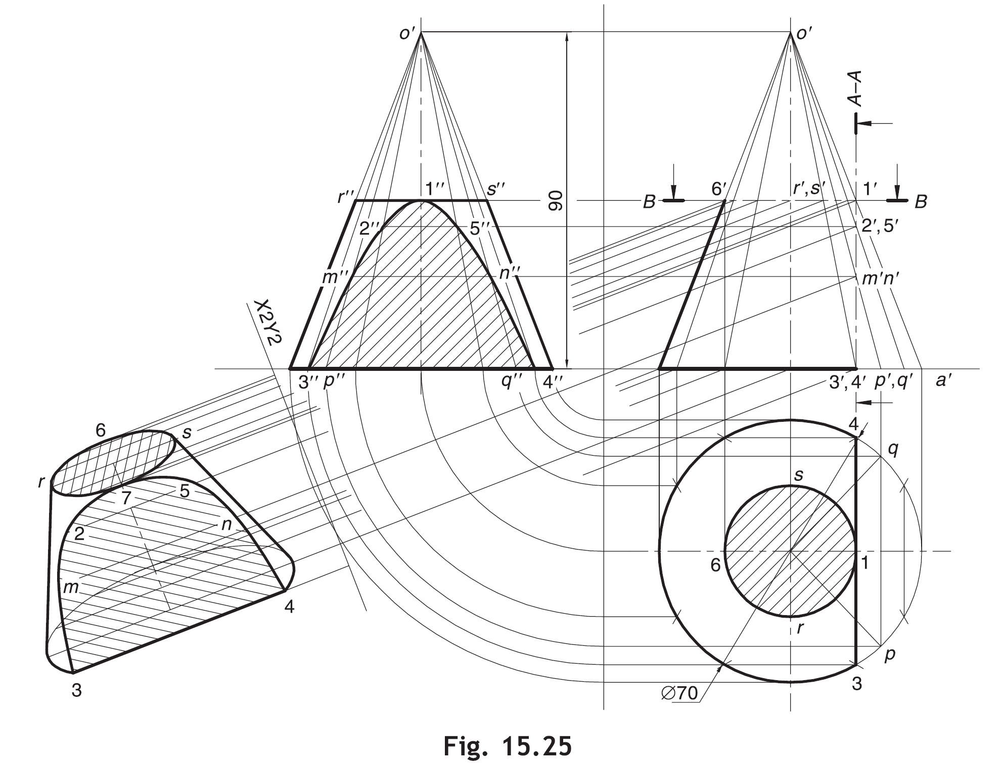

Slide 10

Thank You for Patient Hearing

